Slide 1
The Nucleus’ Physical Role in Collective Cell Migration
Presented By: Brady Hine
Notes:
Hi, I’m Brady and the specific problem I’m trying to address this year in MECH 498 is how mechanical properties of the cell nucleus affect the process of collective cell migration.

Slide 2
Recap
Significance
Problem
Cell repopulation
Wound healing
Developmental tissues
Collective migration
Nucleus limiting factor
Scratch wound assay
Notes:
To recap, collective cell migration is a necessary function for many biological processes to work effectively including, but not limited to, repopulation of cells after tissue engineering, wound healing mechanisms, and formation of developmental tissues. The nucleus’ importance in this is that it serves as a limiting factor for migration due to it often being the largest and stiffest organelle in the cell. To investigate the effects of these impacts on collective cell migration a scratch wound assay model is being used where a layer of cells is cultured, a scratch is applied, and time lapse imaging of the healing process is then used to quantify migration parameters.

Slide 3
Specific Aims
Aim #1 - Establish a scratch wound assay of cell migration using NIH-3T3 cells
Aim #2 - Observe how changes to nuclear mechanics affect migration parameters
Aim #3 - Perform live imaging of the cytoskeleton and nucleus at high resolution to quantify a strain map in the cell monolayer
Notes:
This project has three specific aims. The first being to establish the scratch wound assay including determining methods for quantifying migration and validation of the setup. The second aim for the project involves observing how changes to nuclear mechanical factors impacts the quantified migration parameters. And the final aim includes high resolution imaging of the cytoskeleton and nucleus to develop a strain map at the cell monolayer level.

Slide 4
Fall ‘21 Progress
Assay Setup
Confluence timing (2-3 days)
Scratch Methodology
Imaging timeframe (~12 hours)
Cell Staining
Fixed: nucleus (DAPI) and actin (phalloidin)
Live: nucleus (NucBlue) and actin (Lifeact)
Image Processing
Automated cell tracking
Notes:
Efforts last semester focused on the first aim of establishing the scratch wound assay. This included determining cell culturing time, scratch methodology, and the imaging timeframe required for optimal imaging of the migration process. Work was also done establishing cell staining methods and timing for the nucleus and actin in both live and fixed cells. The two images here help visualize some of the progress made with the left being the first scratch attempt with no migration compared to the right with cleaner edges, cell staining, and migration observed. The end of the semester was then used to work on image processing, specifically using automated cell tracking to collect cell specific migration parameters.

Slide 5
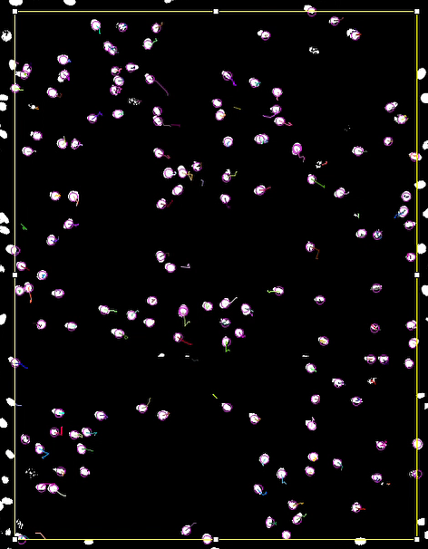
Spring ‘22 Progress
Automated Cell Tracking
ImageJ + TrackMate
Assay Validation
Y27632 application & setbacks
Notes:
Since our last update presentations, a method for automated cell tracking has been established using ImageJ and TrackMate and an output sample is shown here to visualize what the software is doing. Here, the white spots are stained cell nuclei, the spot detection is shown as purple rings, and the cell paths over all frames are shown as the colored lines. This then allows us to collect cell specific data of the collective migration process. A large amount of time this semester has also been spent validating the test setup, using the drug Y27, due to setbacks from cultures dying even prior to drug application. Troubleshooting this issue has taken a few weeks during which culturing earlier cell passages was attempted which refers to how many times the cells have been harvested and reseeded. This still didn’t work so a deep clean of the cell culture room was conducted including incubators, water baths, and fume hoods. We believe this may have solved the issue as cells cultured yesterday are still alive as of today.

Slide 6
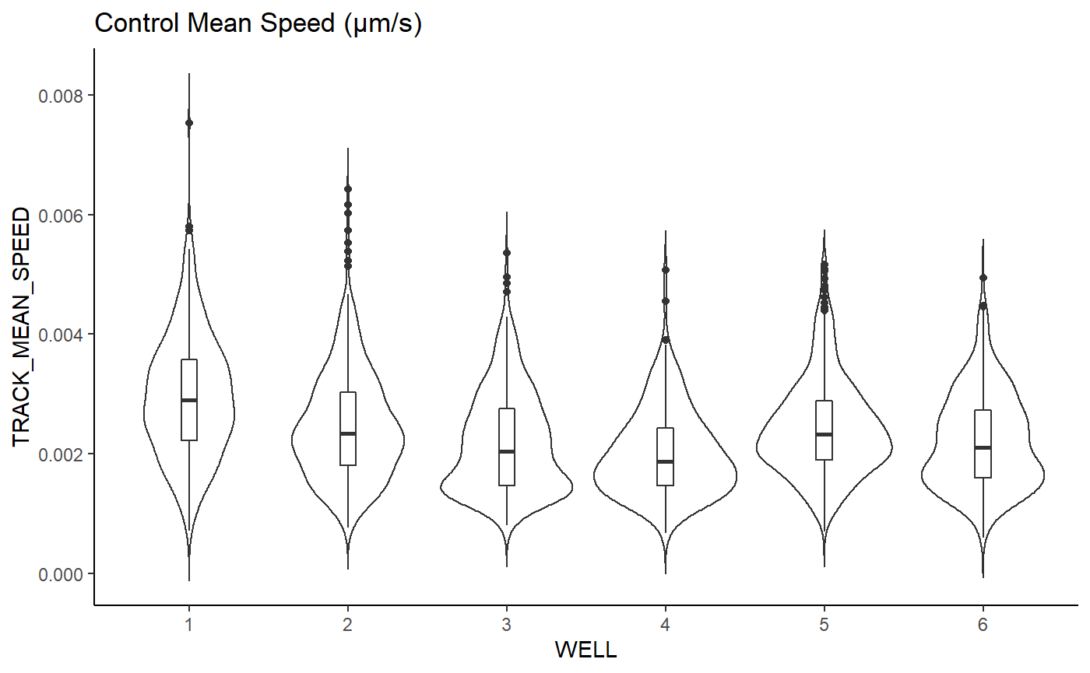
Spring ‘22 Progress
Control Data Collection
Non-normal distributions
Parameters of Interest
Mean Speed
Track Displacement
Track Distance
Persistence
Notes:
Prior to issues with the assay validation, we were able to collect control data for our migration parameters including speed and persistence of the cells. The data had a fairly skewed distribution, so a median approach was taken allowing us to generate violin plots to represent the data. These plots are similar to box and whisker plots except they also show the data distribution along the sides. This graph represents mean speed of the control cells across 6 different wells and shows that the control cells exhibited similar speeds in the wound from well to well. This is just our control data so further analysis will be done comparing these values to those taken after modifying nuclear mechanical properties to provide more useful insight.

Slide 7
Timeline
Project GANTT Chart | December | January | February | March | April
1 – Aim 1 Baseline
2 – Aim 1 Validation
3 – Aim 2 Data Collection & Analysis
4 – Aim 3 Experiment Replication
5 – Aim 3 Strain Mapping
6 – E-days Preparation
Notes:
This was our originally planned timeline in reference to the project’s specific aims and currently we are now starting Aim 2 here. As mentioned previously there have been some setbacks with Aim 1 which did delay the previous timeline. However, these delays allowed time to be diverted to streamlining image and data processing for the project which should accelerate the completion of Aim 2 and get us back on track. Prior to mid semester presentations in March, we plan to have data collection completed for Aim 2 and a majority of the image and data processing.
GSK126 – EZH2 gene inhibitor
EZH2 – codes for histone methyltransferase – histone methylation compacts chromatin
GSK126 – softens nucleus
Found to inhibit cell migration in some cancer cell lines yet helps migration here
TSA – histone deacetylase (HDAC) inhibitor
HDAC – removes acetyl groups from histones – compacts chromatin
TSA – softens nucleus

